Slide 1
Reproducibility & model reuse
Ben Hall
UCL

Slide 2
Introduction
Model reuse is a key part of the modelling workflow
Does it create risks for the reusing researcher?
No, free lunches!
No free lunches!

Slide 3
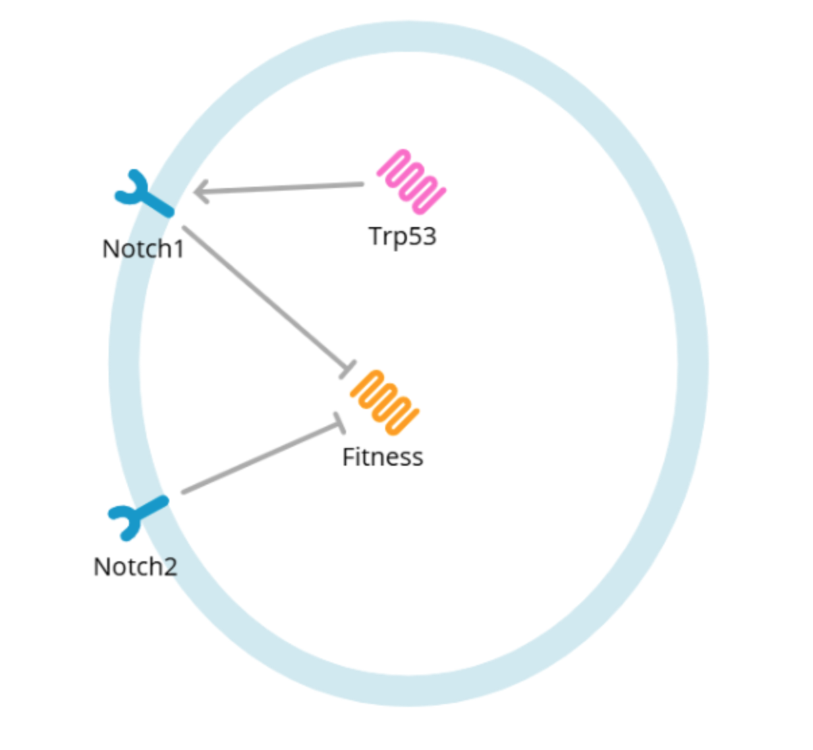
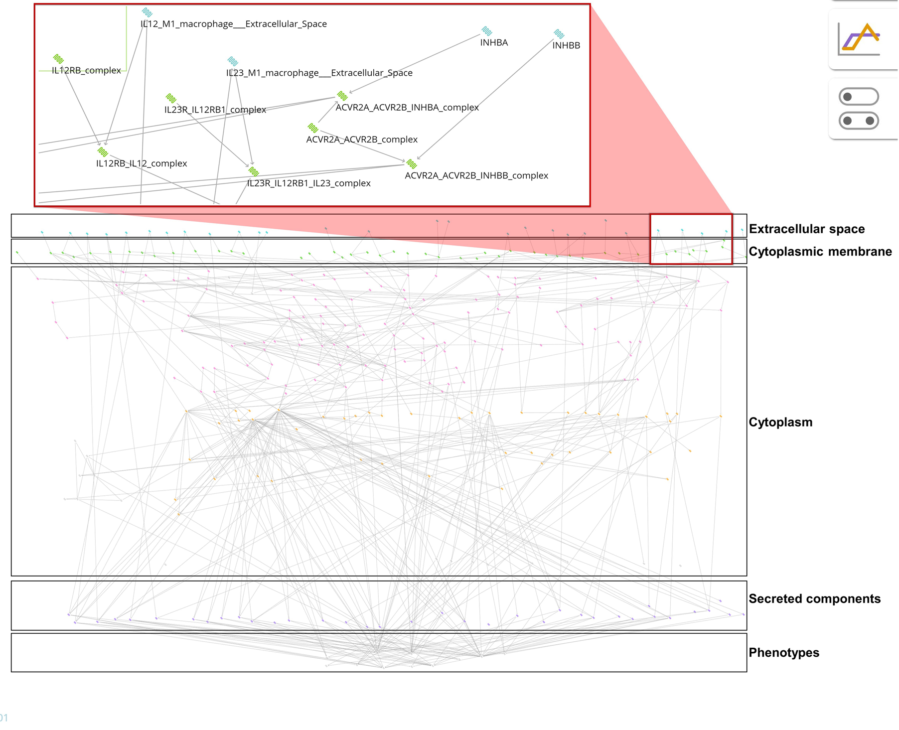

Slide 4
Difference from integration
Single dataset vs knowledge across literature
To move left to right you need to use others work
When you do this you inherit spoken and unspoken assumptions
How you work shapes your models in undocumented ways
When you reuse models (including your own) those undocumented decisions and assumptions become your problem

Slide 5
Introduction
Principles, motivations, and pragmatism
What is reproducibility?
Worked examples of scientific debates around high- and low- dimensional data illustrating the difficulty of trust in knowledge reuse
Experiments are models

Slide 6
Examples in this lecture
Reproducibility is a charged topic
Large scale fraud by Stapel, Schoen, Hellinger
Underpowered or marginal single results that have outsized impact e.g. power poses
The principles and practices are useful and important to engage with
Today;
Discussions taken from the wider literature
Examples taken from personal experience or publication

Slide 7
Reproducibility in the computational sciences
This has been heavily discussed in the field for at least two decades
“Ten simple rules…” series in PLoS Computational Biology
Sandve 2013, Osbourne 2014, Taschuk 2017, List 2017, Carey 2018, Gallagher 2024…. And others

Slide 8
Principles and pragmatism
“We want to emphasize that reproducibility is not only a moral responsibility with respect to the scientific field, but that a lack of reproducibility can also be a burden for you as an individual researcher”
Sandve 2013
Computational science can be held to a higher standard than experimental sciences
Everything (bar hardware) can be shared
Some life scientists have not always engaged in this view
E.g. data and materials for authorship

Slide 9
Balance & culture
Reproducibility and sharing does place a burden on the researcher
Data sharing plans are routine
Data storage needs to be costed and its use planned
Images, raw whole genome data etc can be expensive
This increases if intermediate results are included
As a researcher your expertise is part of your profile
Ownership and intellectual property

Slide 10
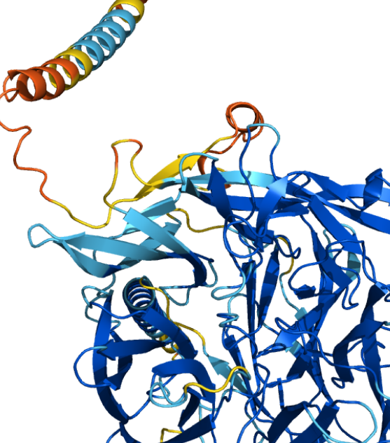
Benefits
AlphaFold trained from publicly shared datasets on models of protein structure dating from 1970s
More generally true of data hungry machine learning approaches
ChatGPT trained on PLoS papers, enabled by permissive licenses
More important but less obvious- individual modelling and bioinformatics studies

Slide 12
What does failed reproducibility look like?
Distinction can be drawn between replication and reproducibility
Replication
I do exactly what you did and get quantitively exactly the same output
Reproducibility
I do something comparable and get qualitatively the same result

Slide 13
Failure to replicate
I ran molecular dynamics on the same system on computers with AMD or intel CPUs and they give different trajectories
Failure to reproduce
I ran molecular dynamics on a protein with Gromacs and Charmm, and the protein unfolded with Charmm
Neither necessarily reflect that results from the calculation are flawed!

Slide 14
Failure to generalize
A more subtle problem in the biological sciences is the failure to generalize
Hypothetical example
Paper title: Mutant clones in normal epithelium outcompete and eliminate emerging tumours
General, broad statement implying universality
Paper data: Mouse model of aging, computational analysis & modelling
Specific, limited though related to human data
If I repeat it with a new mouse strain, or a different approach to modelling aging, this a failure to generalize (title) but does not contradict the data
Biology as a science of the specific- bespoke experiments that talk to single systems

Slide 15
Key principles of reproducible software development
Only commonly agreed listed; many more available
Code and data sharing under permissive licenses
Documentation & revision control
Toolchain recording
Tests

Slide 16
Code & data sharing
I can rerun your code and get the same output
I can adapt your code and data to my problem

Slide 17
Documentation and revision control
I can understand how your code is expected to work, and your choices in implementation
I can modify and extend the code knowing how different components are expected to run
I can find where bugs were introduced and why

Slide 18
Toolchain recording
I can see what external software and hardware you used when running your code
I can ensure that I use the same to maximise the chances of reproducibility

Slide 19
Tests
I can confirm a known result is calculated correctly from individual subroutines
If I reimplement, I can confirm that I’ve not broken specified behaviour
If I find a condition where the function is wrong, I can add a test that reflects the condition and use it to confirm I’ve fixed the bug

Slide 20
Barriers to sharing & reproducibility
Data sensitivity & consent
Culture

Slide 21
Data sensitivity, consent, and GDPR
Data derived from humans is sensitive; personal data especially (genomic sequencing)
Individuals may give limited consent
Blood sequencing genomic dataset that can only be used for aging
This has implications for sharing and processing
Specific security requirements
New approaches (GEL and others)- trusted research environments allow users to access data under control

Slide 22
Cultural
Data and code are extremely portable
Culture in biological sciences is in transition
“data parasites”
Fundamentally- an argument needed to be led by scientists and funders
How do you enforce compliance with a principle? How much is enough?
How to deal with missing data?

Slide 24
A contrarian take: reproducibility failures can be an instructive and natural part of research
If I share my whole tool chain, you should be able to replicate my results exactly
This is substantially easier in computational science compared to experimental science
Where parts of a workflow are unclear, they need to be rediscovered
If the result is dependent on one component, this speaks to the robustness of the results and points to a previously unstated role

Slide 25
One dataset, two metabolomics papers
Shorthouse et al and Cherkaoui et al 2022 (Molecular Systems Biology) both analysed the same raw data on cancer cell line metabolomics
Each paper gives unique insights
Shorthouse shows the relationship between gene variants and specific metabolic signatures, and integrates with other omics datasets to link e.g. drug sensitivities to metabolic state
Cherkaoui finds two populations of metabolic types related to the epithelial mesenchymal transition, key in metastasis

Slide 26
One dataset, two processing approaches
Each paper processed the same raw data and validate their data in a different way
Shorthouse used a common workflow, normalising for cell size & confluency, plus filtering aberrant metabolites, and validated by looking for patterns and relationships observed in other published metabolomics datasets
IDH mutation and metabolite accumulation
Distribution shape
Cherkaoui applied multiple different workflows, and used a scoring approach based on common bioinformatics guidelines

Slide 27
Interpretations are dependent on workflow
Results from both papers do not reproduce completely on the alternative processing
Not absent, but individual tests are below significance
Validations for Shorthouse based on other datasets (unimodality, known variant-metabolite relationships) unsuccessful for Cherkaoui; Shorthouse processing considered but rejected in Cherkaoui due to low score

Slide 28
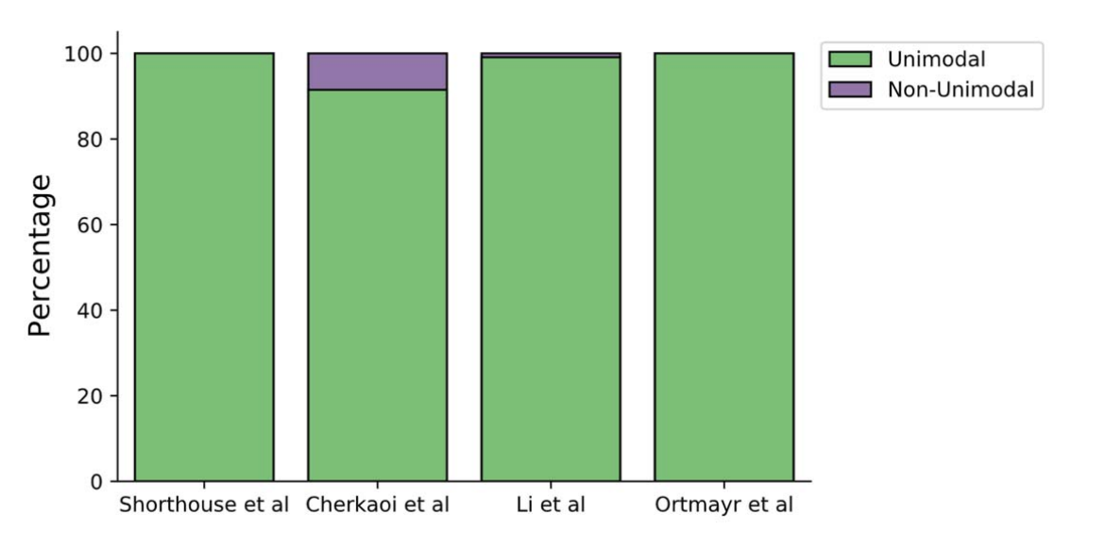

Slide 29
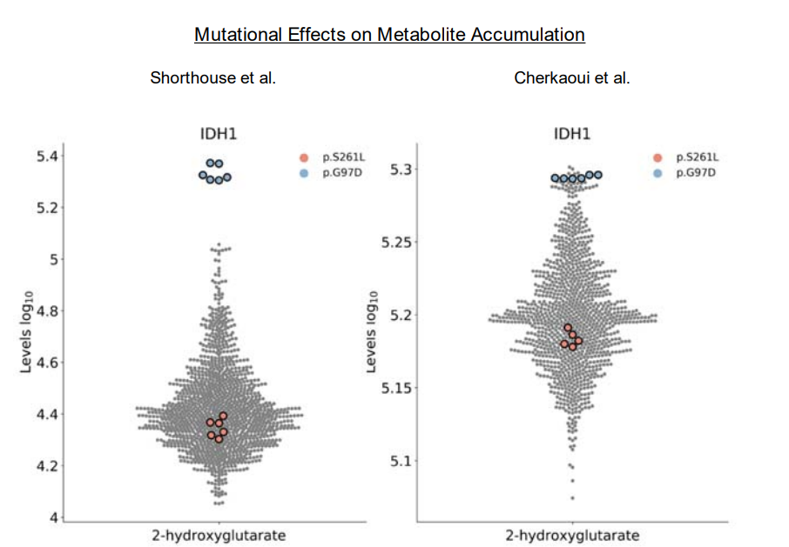

Slide 30
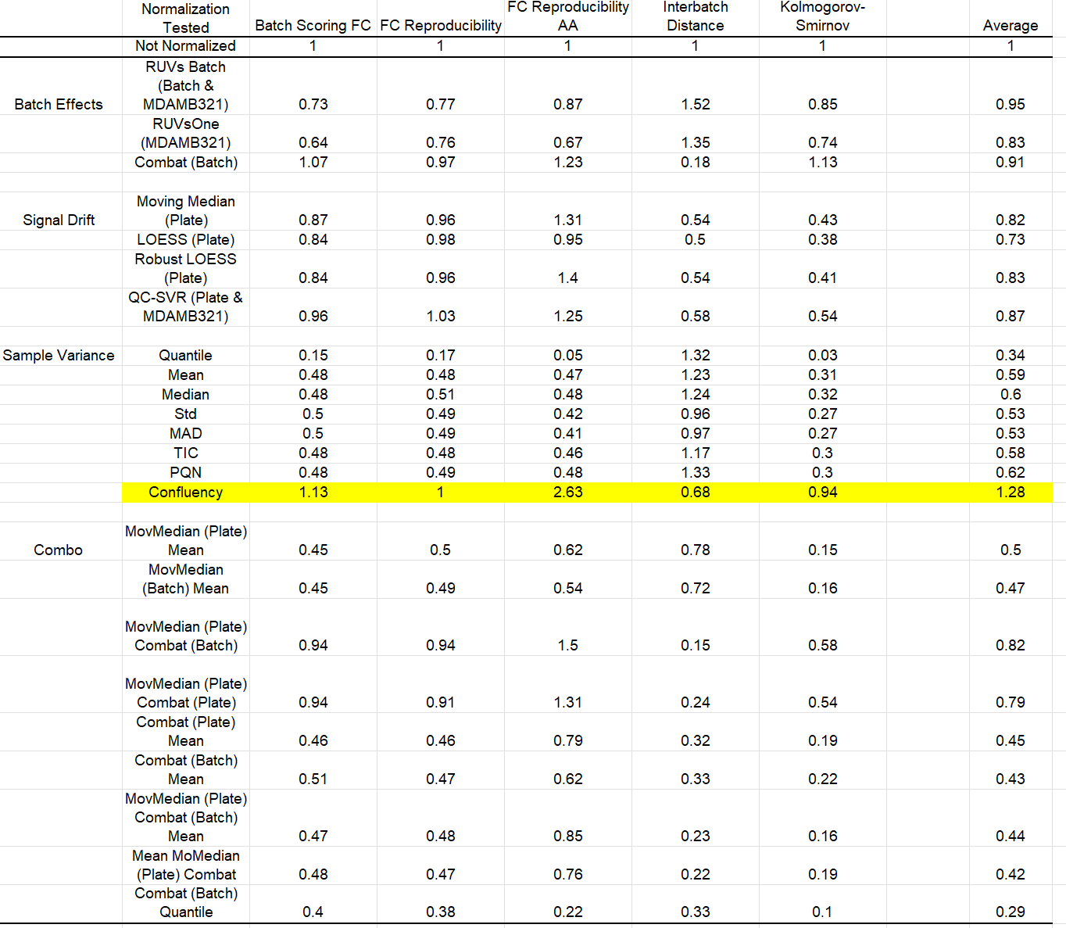

Slide 31
But which one is right?
Both and neither; the divergence reveals that the choice of workflow is important
Neither approach is straightforwardly wrong; each workflow is acceptable
An important corollary to the acknowledged importance of reproducibility; failure to reproduce might reflect incomplete knowledge rather than incompetence or dishonesty
Discovering our ignorance is part of research!

Slide 32
Disagreement is not necessarily rooted in a failure in reproducibility
The structure of the stem cell population in squamous epithelia
Piedrafita 2020, Nature communications
Single progenitor vs hierarchical models ongoing debate in literature
1960s- stochastic fate determination (Le Blond)
1990s- hierarchical model of slow cycling stem cells and transient amplifying cells (Jones, Watts)
2010s- single progenitor model (Jones, Simons)
2020s- hierarchical models (Simons, Blainpain) and single progenitor (Hall, Klein, Jones, Greco)

Slide 33
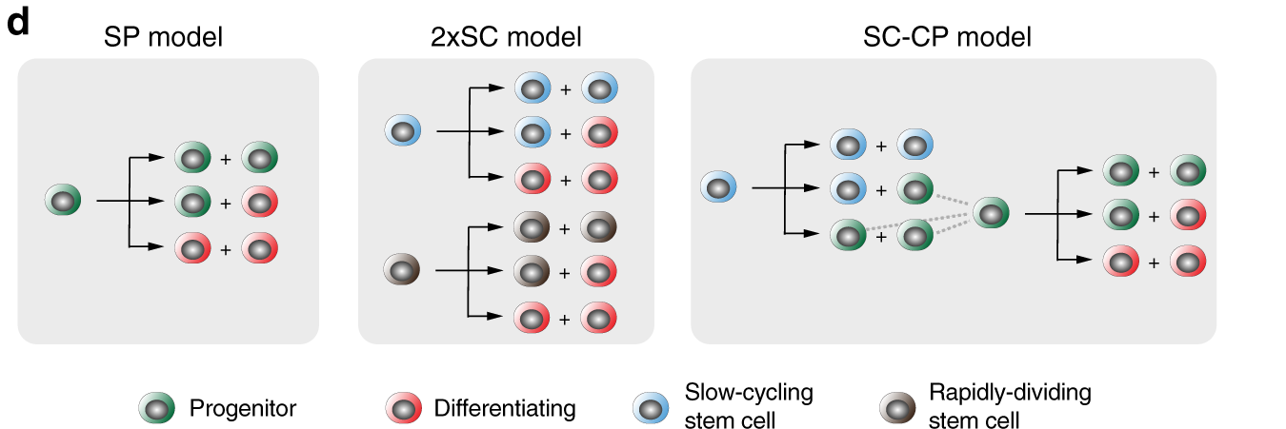

Slide 34
Evidence
Hierarchy
Histone dilution experiments reveal “label retaining cells” that remain bright whilst other cells divide
Small numbers of surviving clones over time
Recently- clone size distributions
Single progenitor
Linear growth in average clone size over time
Histone dilution experiments with antibodies to label immune cells

Slide 35
Modelling
Hierarchical models have historically been deterministic
Though recent are not
Deterministic models incompatible with linear growth in average clone sizes
Introduction of stochasticity fundamental in enabling single progenitor models
More recent discussions focused on early time points
But- sensitive to choice in cell cycle time distributions
Like-for-like comparisons show similar performance between single/hierarchical models

Slide 36
Disagreement can be founded in a failure to reproduce
Label retaining cells are immune infiltrates, so we cannot reproduce that observation
We cannot find any evidence of a slow dividing population
Heirarchical and single progenitor models both explain clone size distributions comparably with similar cell-cycle time distributions
SP more parsimonious

Slide 37
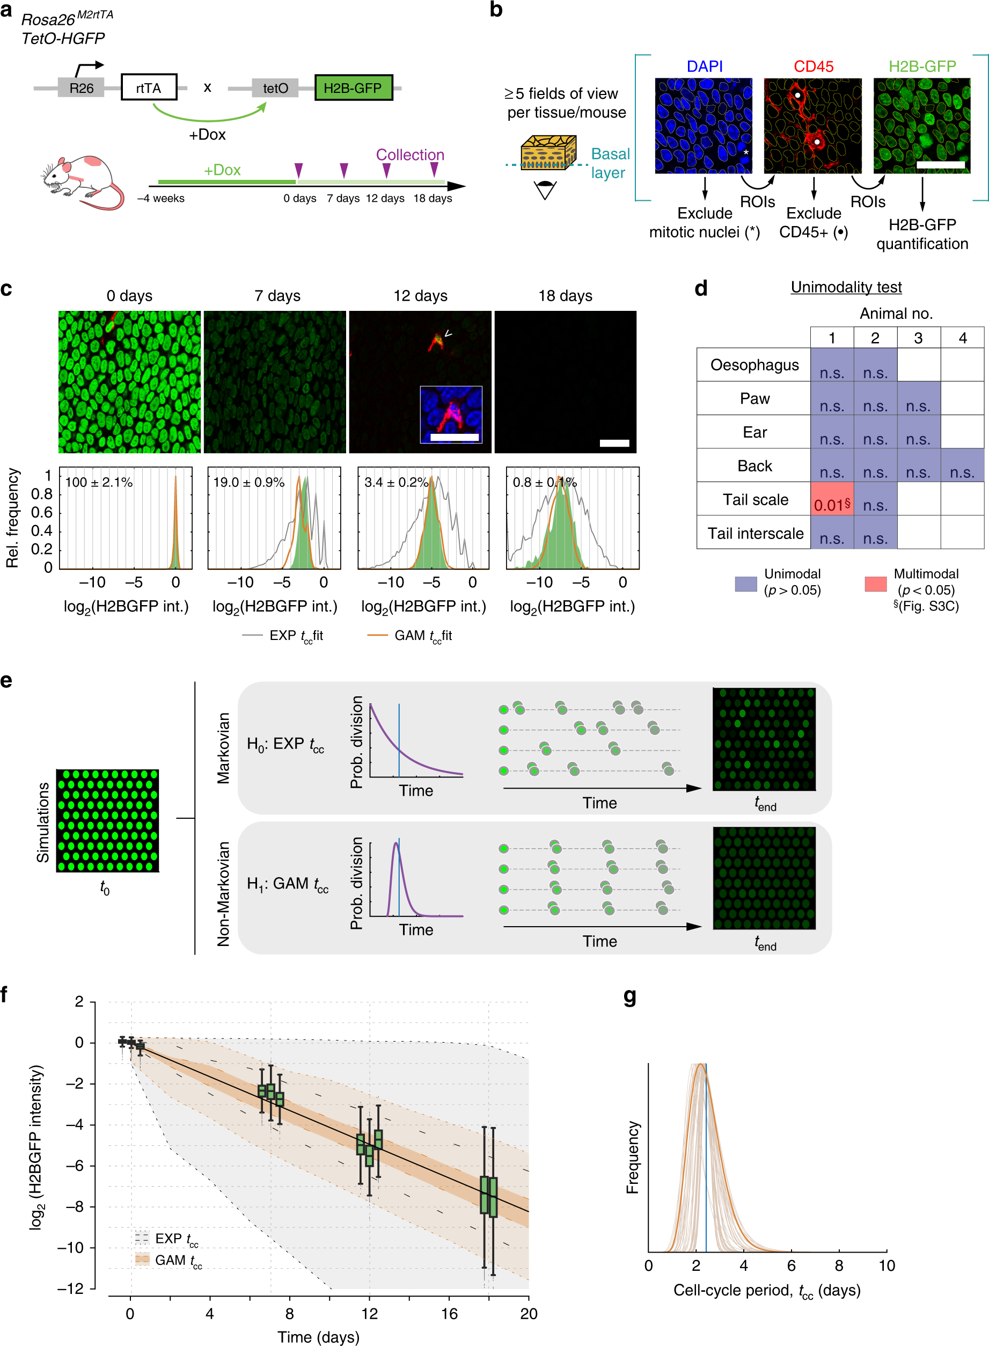

Slide 39
Samples caught mid-division (separated by ½ intensity)

Slide 40
Other ways to fail to replicate/reproduce…
Physical simulations are frequently chaotic; sorting of lists influences the outcome of summing and can lead to trajectory divergence
Hall et al 2014 Biophysical Journal
“Minor” subroutine updates alter outcome of normal mode analysis in Charmm (not published…)
CPUs with different manufacturers in one cluster fit different numbers of water molecules into box
Hall et al 2018 JCTC

Slide 43
Conclusions
Reproducibility in science is an active discussion, with costs and benefits
Integrating the insights of others requires active analysis of their work for confidence

Slide 45
Tooling
Revision control systems (git)
Continuous integration
Environments (conda, docker)

Slide 46
Revision control systems
Git, SVN, RCS, mercurial…
Fundamentally all log changes in code over time, usually with annotation
Assist in collaborative code development

Slide 47
Git basics
Make folder a git repository
git init
Add file in folder to git repository for tracking
git add ReadMe.txt
Log a set of changes
git commit ReadMe.txt –m “Included notes on new CLI options”
Copy local commits to remote repository
git push
Copy remote repository commits locally and combine them (merge) with local changes
git pull

Slide 48
Collaborative git/github
Forking a repository copies a remote repository so that you can make edits
The new (forked) repository is linked to the original
A pull request is made by the owner of a forked repository to the owner of the original repository, requesting that the original include the changes in the forked into their repo
For example, I fork, I fix a bug or add functionality, test to show it works, commit and push my changes to my remote repo, and then make a pull request to the original owner

Slide 49
Environments
The code can be stored in a public repository but could depend on external libraries and programs
These could be included as binaries with the repo, but more common is to include lists of packages to be installed using a package manager
For python, this can be in pip or conda
Conda/anaconda go one step further and allow environments to be created where for each new environment is created as a blank slate and all of the libraries are installed new
Docker goes further and allows you to create containers based on virtual machines

Slide 50
Continuous integration
Continuous integration efforts build on everything we’ve discussed and routinely and automatically compile code, and run tests every time code is checked in
This gives an automatic notification of breaking changes

Slide 52
Guidelines
Random seeds
Data storage (private and public)
Sharing & open source
Code formatting tools

Slide 53
Random seeds
Stochastic simulation is common, and pseudo random number generators enable this
PRNGs do not generate random numbers, they deterministically generate numbers that appear random from a function. This function has one input, a seed
PRNG seeds frequently default to system time, preventing replication
Manually setting the seed avoids this issue and enables replication

Slide 54
Data storage and sharing
Increasingly the expectation is that all data presented in publications should be shared; funders often mandate 10+ years of data storage
This requires data is findable locally
Store data from work in consistent ways to assist searches
/projects/
/projects/CML
/projects/CML/executable-models
/manuscripts/
/manuscripts/CML/
/manuscripts/CML/Figures/Data

Slide 55
Data sharing
FAIR-R guidelines
Findable
Where is the data?
Accessible
Can I download them?
Interoperable
Do I need specialised software to read the data
Reusable
Do I have freedom to reuse this?
Reproducible
…

Slide 56
Public data sharing
Standard format
SI in journals
Public repositories
…where available
…where possible
Image datasets, genomic intermediaries etc can be massive, with cost implications for hosting

Slide 57
Code formatting
Current trend of using code formatting tools to assist readability and standardisation of code styles
E.g. enforce line length, number arguments to functions etc
Discourage “bad” coding practices
Consistent comment style
In principle this aids readability
I’m unaware of anyone actually testing this

